Slide 1

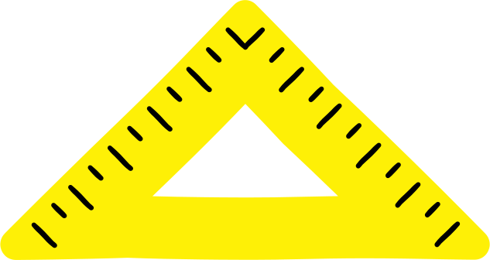



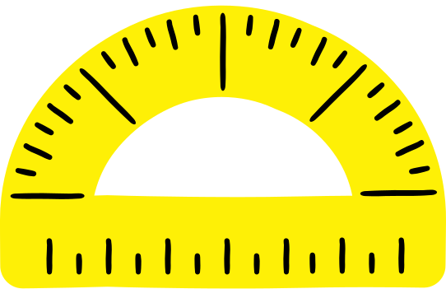
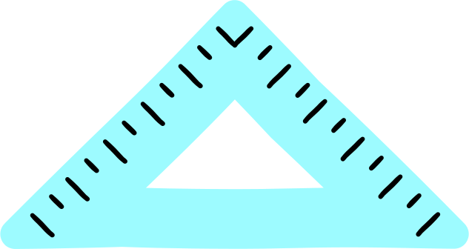
Angles and
Angle Pairs
Do you want to build something?
Understanding and measuring angles is essential when working with space, whether you want to improve an existing project or start a new one!

Slide 2
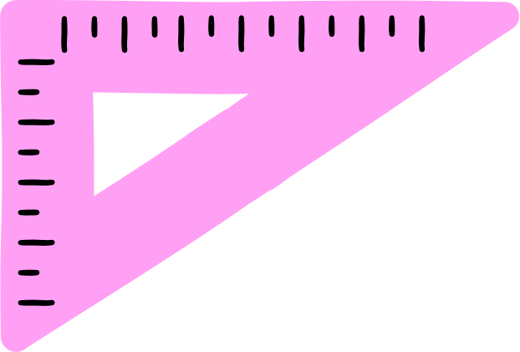




Google Slides
How
to Use?
Click on the "Google Slides" button below this presentation preview. Make sure to sign in to your Google account. Click on "Make a copy." Start editing your presentation.
Alternative: Click on the "Share" button on the top right corner in Canva and click on "More" at the bottom of the menu. Enter "Google Drive" in the search bar and click on the GDrive icon to add this design as a Google slide in your GDrive.
PowerPoint
Click on the "PowerPoint" button below this presentation preview.
Start editing your presentation.
Alternative: From Canva template file, Click on the "Share" button on the top right corner in Canva and click on "More" at the bottom of the menu. Enter "PowerPoint" in the search bar and click on the PowerPoint icon to download.
Canva
Click on the "Canva" button under this presentation preview. Start editing your presentation. You need to sign in to your Canva account.

Slide 3
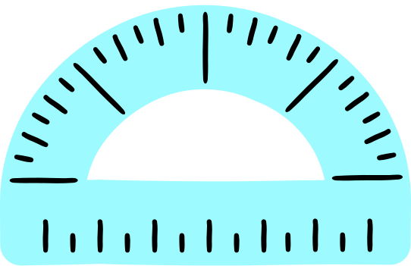
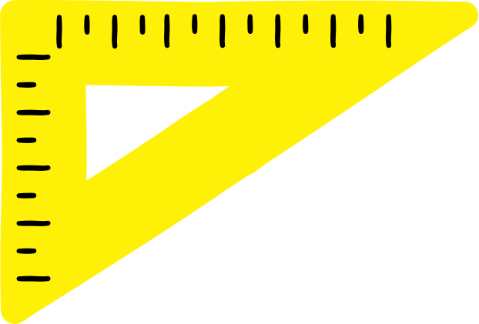



Angles and their Measures
Lesson 01

Slide 4



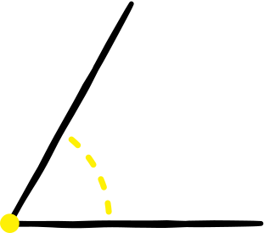

What are angles?
rays
60º
Formed when two rays or line segments meet at a common endpoint called vertex.
vertex

Slide 5

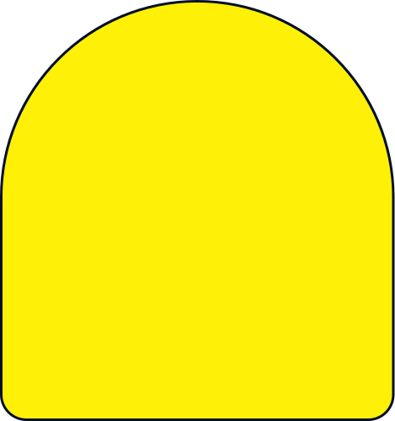
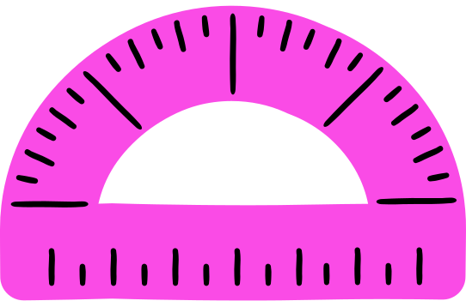
How to measure an angle using a protractor?

Slide 6
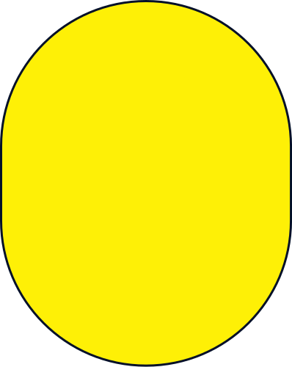


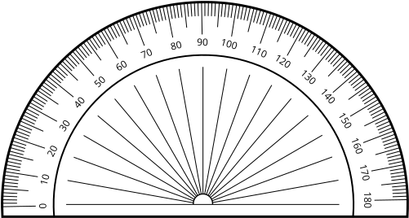
Step 1:
Place the protractor's center point at the angle's vertex.

Slide 7

Step 2:
Align the protractor's bottom line with the bottom ray of the angle at the 0 mark.

Slide 8

Step 3:
Find the angle measure by reading the number where the second ray intersects the protractor.
The angle is 30°

Slide 9
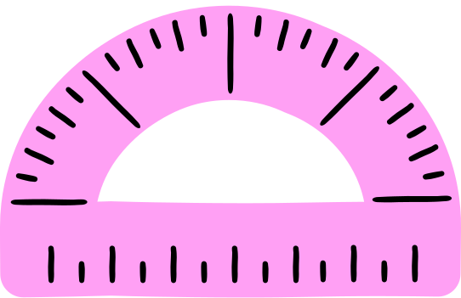
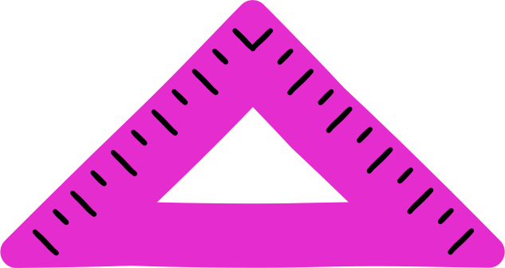
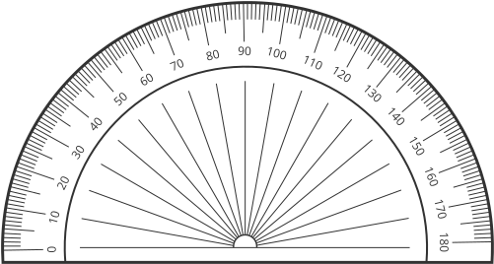

Mastering Angles with a Protractor
The angle is 50°.
The angle is 130°.

Slide 10
Measuring Angles
Lesson 02

Slide 11
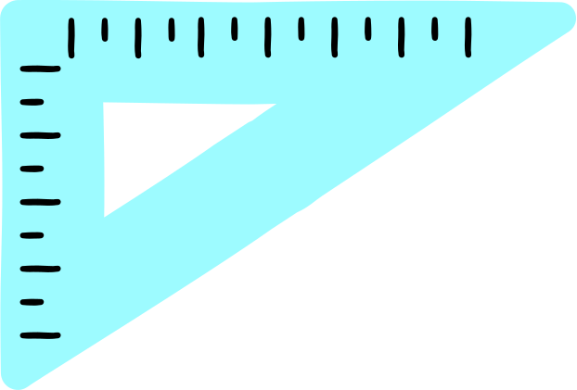

Measuring Angles
Move the protractor and put it over the angles you want to measure. Use the "rotate" icon to adjust the position of the protractor.

Slide 12




The first one is done for you.
130°
Angle :
130°

Slide 13
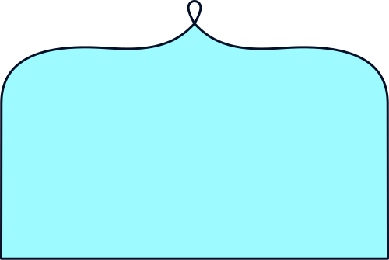



Solve This!
°
°
Angle :
°
Angle :
°

Slide 14


Solve This!
°
°
Angle :
°
Angle :
°

Slide 15





Activity
Time!

Slide 16


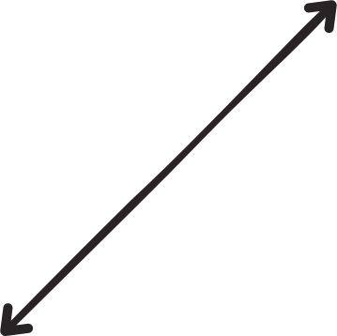



Straight Angle Pairs
Use the protractor below to measure the angles.
Pair of Sample Angle
Sample Angle
Draw the pair of each given angle. The two angles should add up to 180°.
Use Canva's elements and Draw tool.
140°
40°
40°
Make this smaller or bigger as needed!
A 40°-angle
40° + 140° = 180°
Angle A
Pair of Angle A
Angle B
Pair of Angle B
Draw the angle here.
Draw the angle here.
90°
50°
Right angle
Show here that the sum of the pair is 180°.
A 50°-angle
Show here that the sum of the pair is 180°.

Slide 17


Angle C
Pair of Angle C
Angle D
Pair of Angle D
10°
Draw the angle here.
100°
Draw the angle here.
A 10°-angle
Show here that the sum of the pair is 180°.
A 100°-angle
Show here that the sum of the pair is 180°.
Angle E
Pair of Angle E
Angle F
Pair of Angle F
Draw the angle here.
Draw the angle here.
150°
65°
A 150°-angle
Show here that the sum of the pair is 180°.
A 65°-angle
Show here that the sum of the pair is 180°.

Slide 18



Thank you!

Slide 19
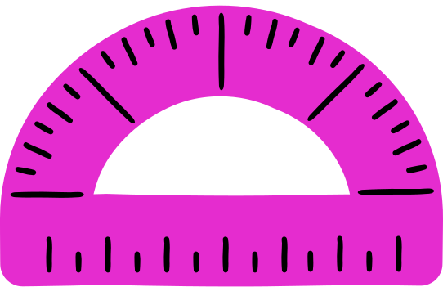

Resource
Page
Use these design resources in your Canva Presentation.
This presentation template uses the following free fonts:
Titles: Laila
Headers: Kite One
Body Copy: Nunito
You can find these fonts online too. Happy designing!
Don't forget to delete this page
before presenting.

Slide 20

This presentation template is free for everyone to use thanks to the following:
SlidesCarnival for the presentation template
Pexels for the photos
Happy designing!

